Slide 1
CS/RBE 549 COMPUTER VISION
LECTURE 3 – HOMOGENEOUS COORDINATES & IMAGE OPERATIONS

Slide 2
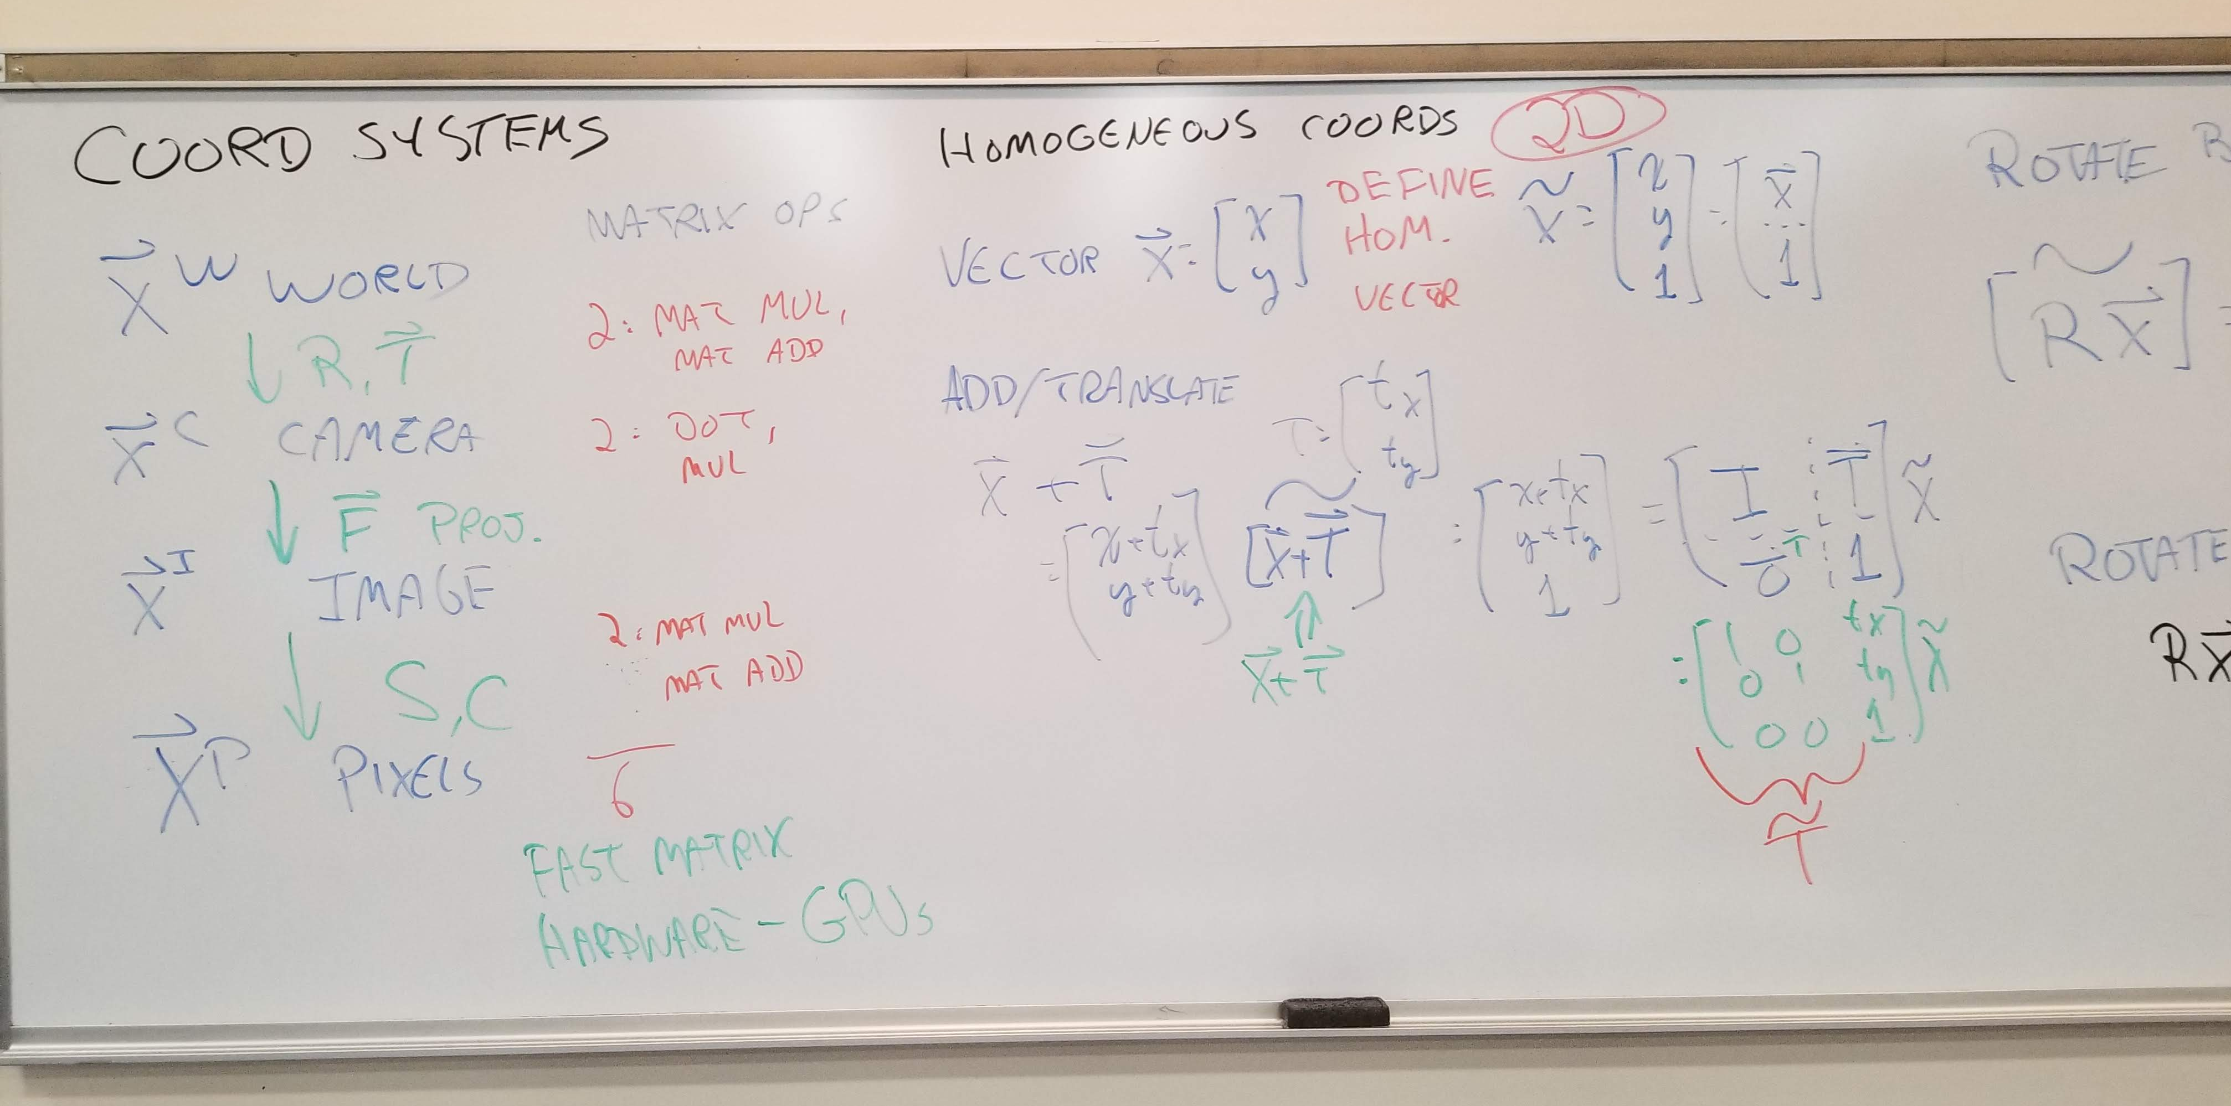

Slide 3
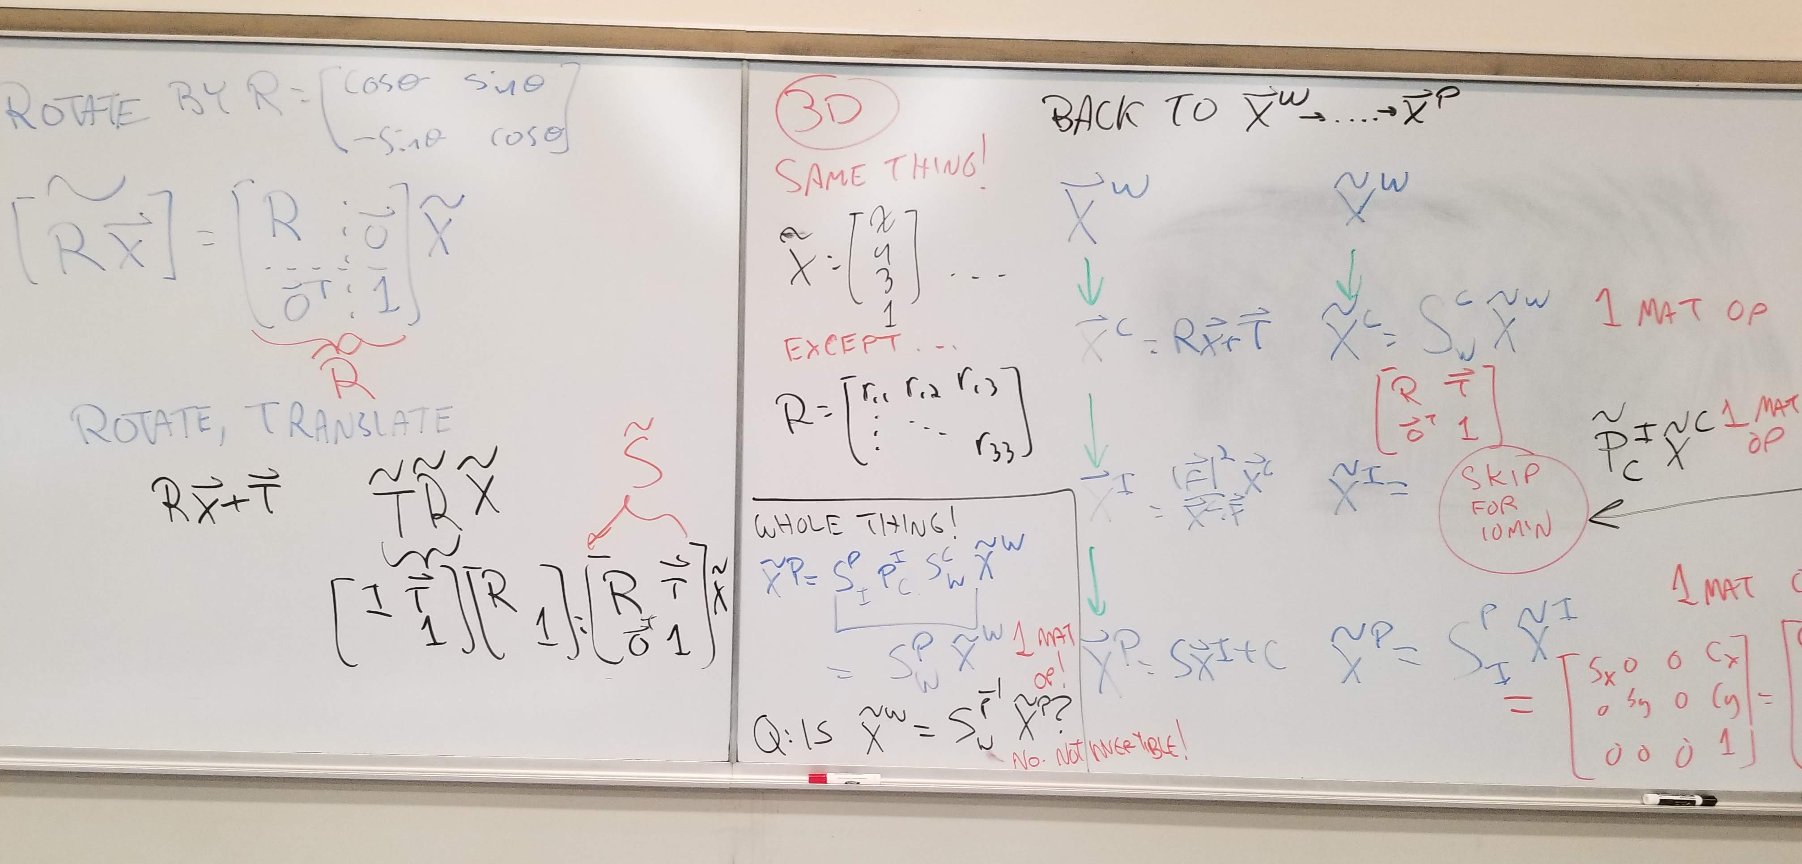

Slide 4
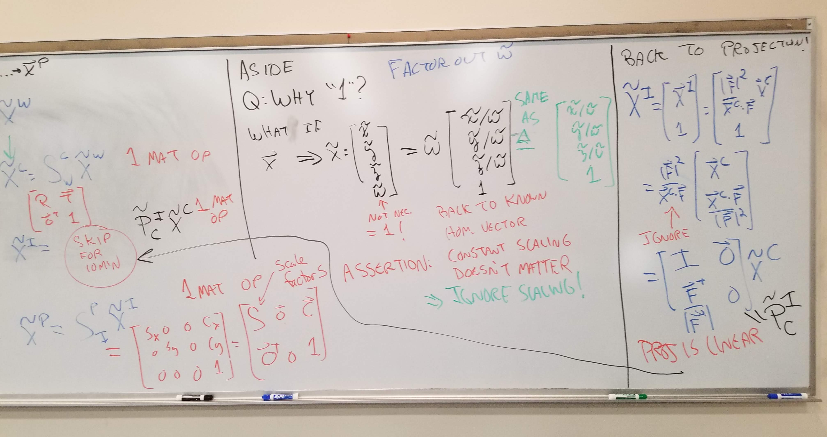

Slide 5
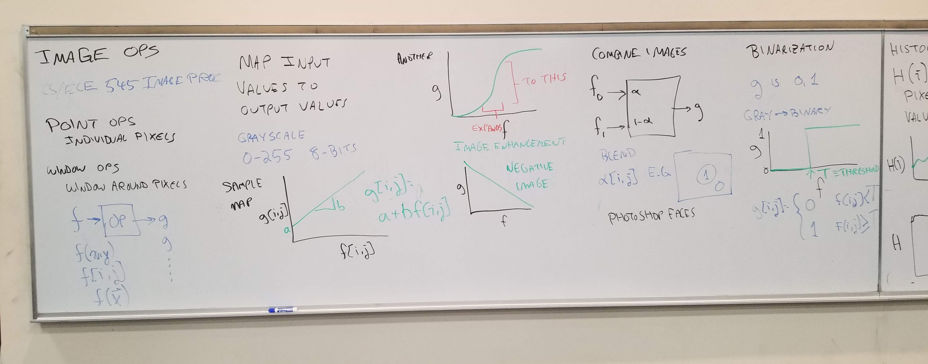

Slide 6
